Slide 1
Impact of defeat in the 1st Sino-Japanese War
Use these next four pictures to jog your memory
How do they all fit together and link to last lesson?

Slide 2
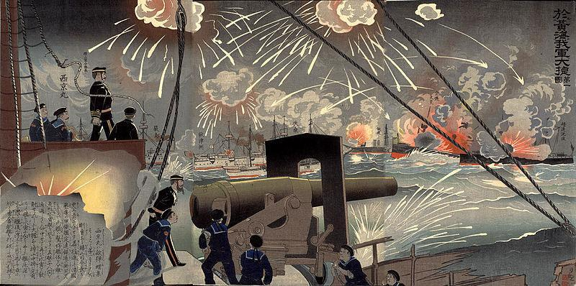

Slide 3
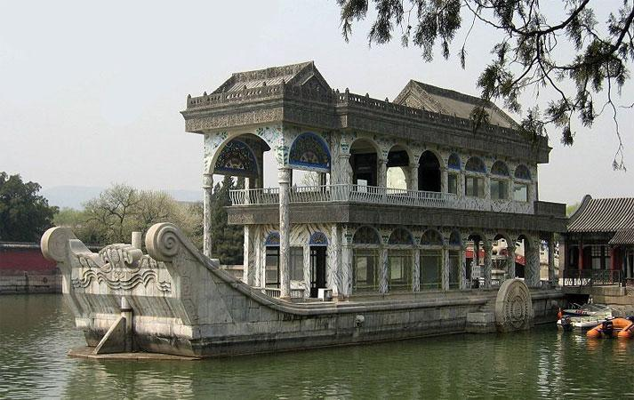

Slide 4
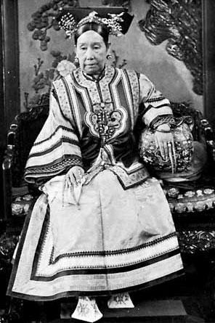

Slide 5
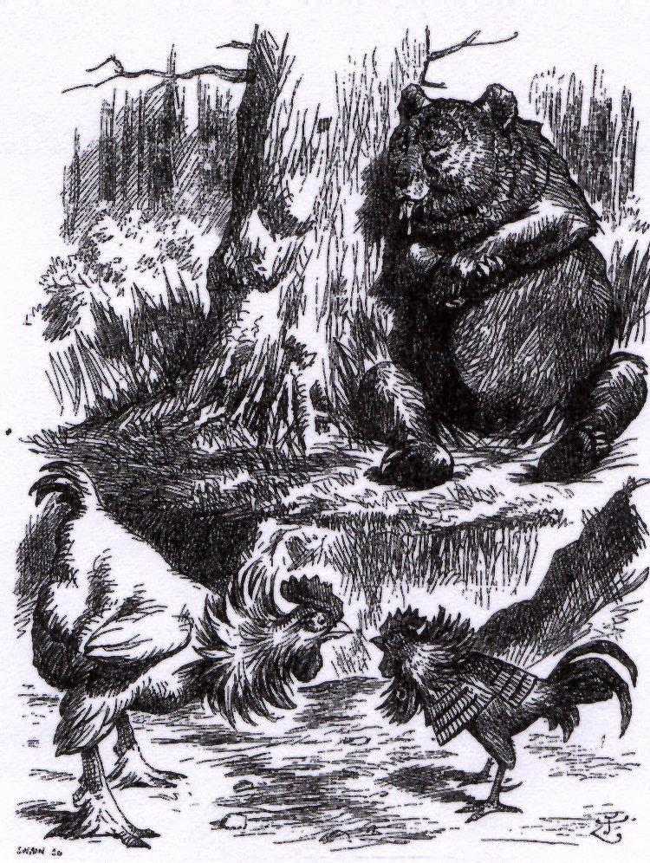

Slide 6
JAG Roberts
“The disastrous defeat in the Sino-Japanese War destroyed the credit of the self-strengtheners and raised acute fears for the nation’s survival.”

Slide 7
Significance
Why is Roberts arguing the Sino-Japanese War is significant?

Slide 8
“In its aftermath, in response to the scramble for China, a determination to embrace all practical means to preserve China may be observed, for example in the rights recovery movement”

Slide 9
The Rights Recovery Movement
“Brought together officials, gentry and merchants in endeavours to recover concessions granted to the foreign powers.”

Slide 10
JAG Roberts
“From these incidents and from the social changes which occurred in the late 19th century, there developed the sentiment which may properly be called Chinese nationalism”

Slide 11
Treaty of Shimonseki (1895)
The treaty was negotiated Li Hongzhang and Ito Hirobumi. China was forced to accept harsh conditions:
Completely renounce suzerainty over Korea.
Pay an indemnity of 300 million taels ($200 million).
Open seven new ports for trade and extend most favored nation status to Japan.(what one country gets Japan gets as well)
Cede the Liaotung Peninsula, Formosa (Taiwan), and the Pescadores to Japan.
Notes:
*
Li and Ito had met before. Supposedly, Ito asked Li, “Ten years ago I talked with you about reform. Why is it that up to now not a single thing has been changed or reformed.” Li’s reply was succinct, “Affairs in my country have been so confined by tradition that I could not accomplish what I desired.”
Some felt that the treaty marked the end of the mandate of heaven for the Qing dynasty. Others recognized that the treaty ended the old Confucian view of international relations. There was no longer any East Asian family of nations. China was no longer the “middle kingdom” for there were no longer any dependent states that recognized her superiority. The indemnity represented 15% of Japan’s GNP at the time. It ultimately financed the building of the Nippon Steel Corporation on southern Kyushu. Nippon Steel is currently the world’s largest steel producer.

Slide 12
The Triple Intervention
Six days after the Treaty of Shimonoseki was signed, Russia (the instigator), France and Germany “advised” Japan that it would be wise to give back the Liaotung Peninsula. After a week’s delay, Japan agreed to do so.
Within three years, Russia had leased the peninsula, established a naval base at Port Arthur and obtained agreement to build a link to the Trans Siberian Railroad.
Notes:
*
Note that Britain was not a party to the Triple Intervention. Britain considered itself a “friend” to China, but had mixed interests. It did not want China partitioned. The ceding of the Liaotung Peninsula would have been the first step in that process. By the same token, the opening of additional ports offered the opportunity for greater trade and profit.
Russia obviously had the most to gain. Japan’s victory in the war resulted in Russia being preempted in its drive for influence in the Far East. Germany was concerned over the possibility of partition as it had its eye on several possible lease holds. Additionally, Germany felt that if it kept Russia involved in the Far East, it might not have to deal with it in Europe. France was primarily concerned about partition.

Slide 13
Consequences- Hsu
“The humiliating defeat on land and at sea after more than thirty years of self-strengthening exposed Li to severe criticism and impeachment. His defense was that victory was impossible when only his Peiyang fleet and Huai army fought against the whole might of the Japanese nation. Be that as it may, Li was dismised, disgraced, and divested of the Yellow Jacket, a mark of imperial favour”

Slide 14
More Consequence Hsu
Intensification of Imperialism
Oppression of Native Industries
The rise of Japan
New political movements in China: Radicals and Progressives

Slide 15
Impact of the Sino-Japanese War: The Scramble for Concessions
Learning Objective:
To explain the ‘Scramble for Concessions’
To explain we must do more than describe, we must look before and after

Slide 16
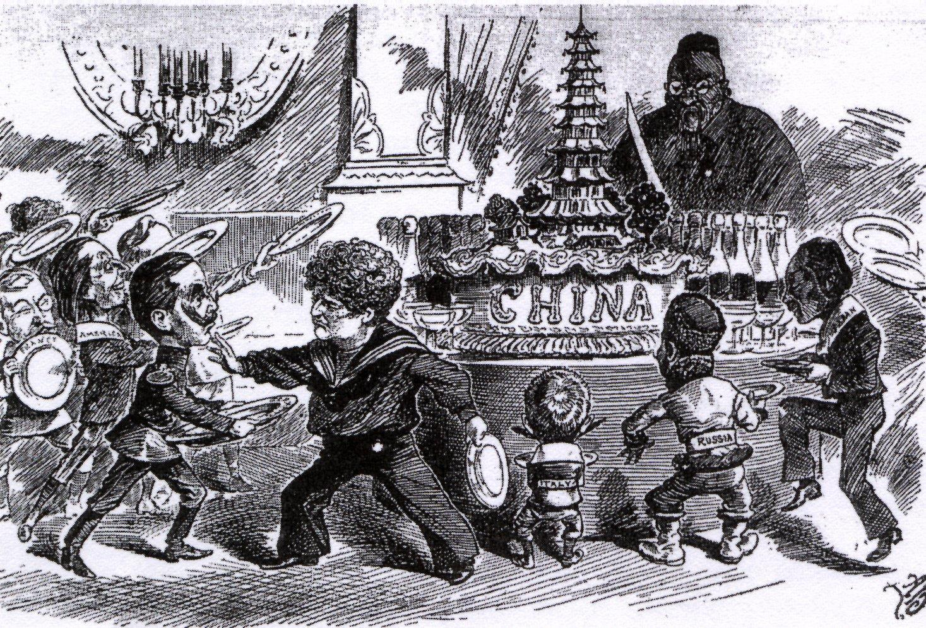

Slide 17
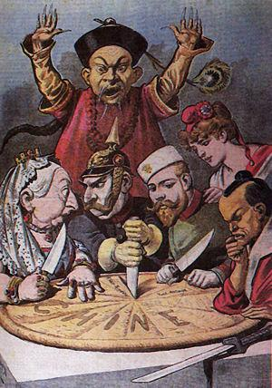
Notes:
*

Slide 18
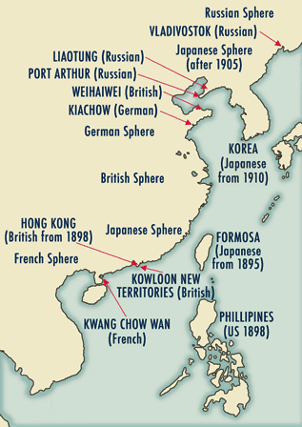

Slide 19
Trigger: Juye Incident
a band of twenty to thirty armed men broke into a Catholic missionary compound in Juye County (Shandong province, China) and killed Richard Henle and Francis Xavier Nies, two German missionaries
A few days later, Germany took these murders as a pretext to seize Jiaozhou Bay on Shandong's southern coast, triggering a "scramble for concessions" during which Russia, Britain, France, and Japan also secured their own sphere of influence in different regions of China
Notes:
*
Also leads indirectly to the later boxer uprising

Slide 20
Historiography
Paul Cohen has called the Juye incident "the opening wedge in a process of greatly intensified imperialist activity in China,"
Joseph W. Esherick comments that the Juye killings "set off a chain of events which radically altered the course of Chinese history."

Slide 21
Hsu
Russians move in on Liaotung Peninsula (China had bought it back from the Japanese); Port Arthur and Darien leased (with bribes)
British lease Weihaiwei and Kowloon New Territories for 99 Years
French leases Kwangchow Bay for 99 years

Slide 22
Q1 How could you best describe the Scramble for concessions?
Various nations taking advantage of China’s weakness after military defeats
Various powerful countries taking control of different parts of China
When some nations see an opportunity to take things from another country
After China’s defeat in Sino-Japanese war its weakness entices the Western countries to take large chunks of it
Western nations exploiting power after Chinese military defeats. E.g.: UK Kowloon new territories for 99 Years lease

Slide 23
Leads to Open door Policy-Hsu
“The Open Door was a declaration of principles rather than a formal policy of the United States, which had neither the will nor the power to enforce it militarily”
“Strangely, the partition of China tapered off after the declaration, not so much because the imperialists respected the American call, but because they feared rivalry and conflict amongst themselves.”

Slide 24
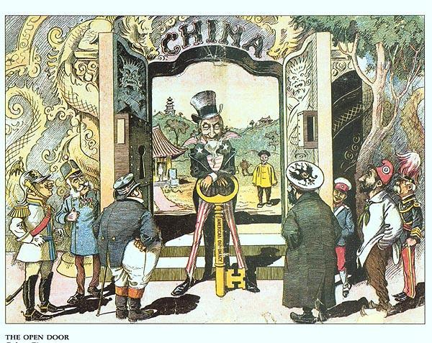
The Open Door

Slide 25
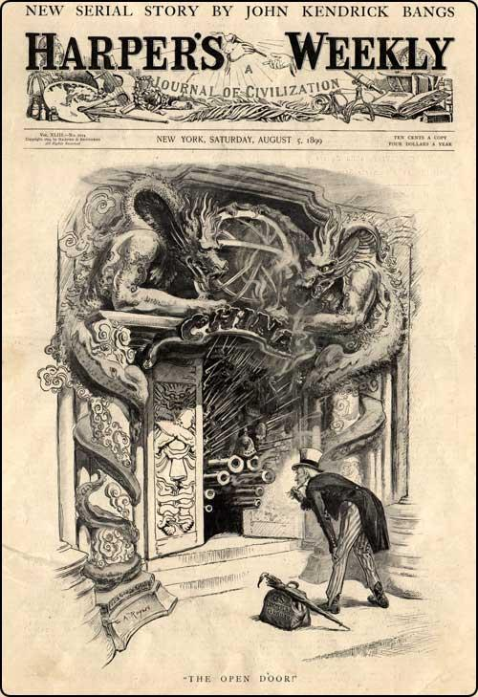

Slide 26
Q2 How is the Open Door Policy connected to the Scramble for Concessions?

Slide 27
Impact of defeat on China?
E.g.: Development of nationalism
Awareness of need to reform
Anything else?

